Slide 1

COVIDPat: Frequent Pattern Discovery on COVID-19 Knowledge Graph
Dr. Bo Tang (唐博)
tangb3@sustech.edu.cn
April 2020, SUSTech

Slide 2
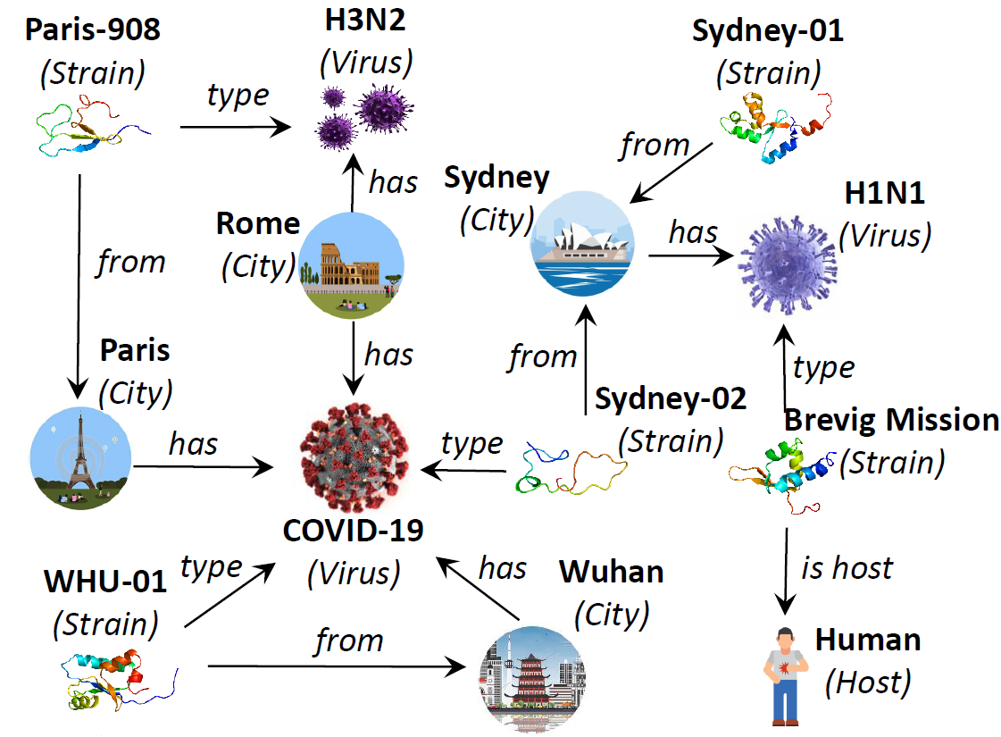
COVID-19 Knowledge Graph

Slide 3
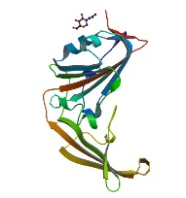

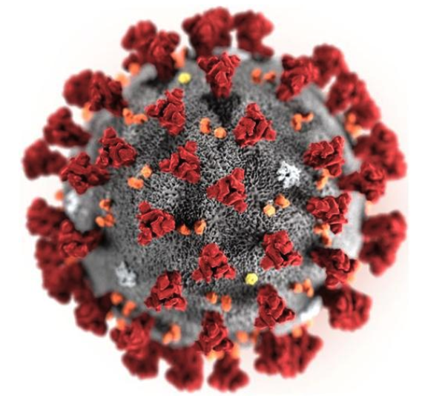

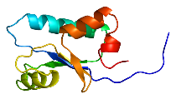


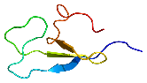
Frequent Pattern Example
(Strain)
(City)
Sydney-02
(Strain)
from
Sydney
(City)
from
type
type
2019-nCoV
(Virus)
(Virus)
(a) Pattern
(b) Instance 1
2019-nCoV
(Virus)
H3N2
(Virus)
type
WH-01
(Strain)
type
Paris-908
(Strain)
from
Wuhan
(City)
from
Paris
(City)
(c) Instance 2
(d) Instance 3

Slide 4
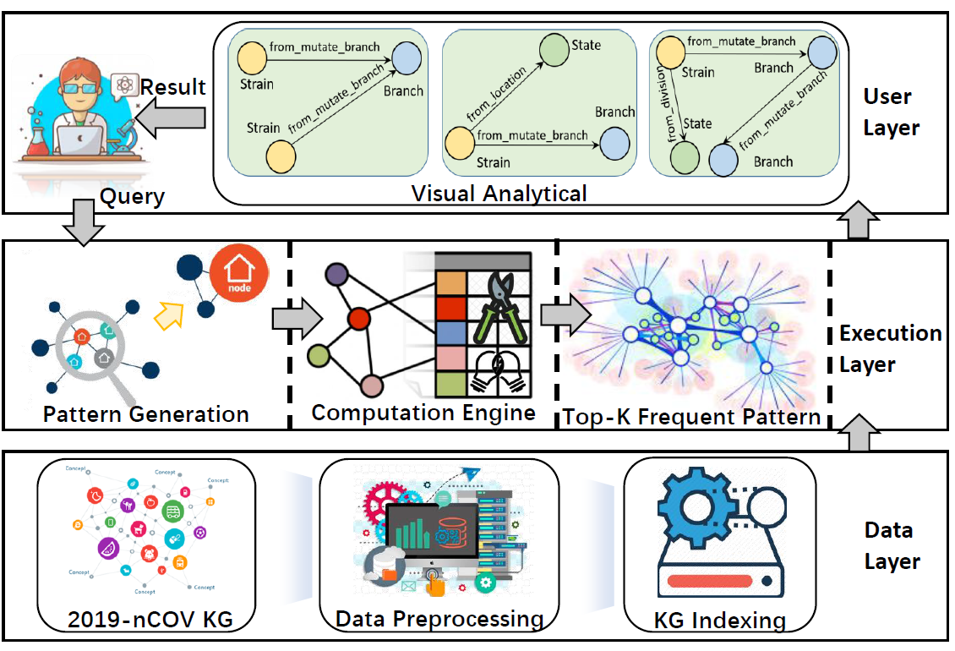
COVIDPat: System Architecture

Slide 5
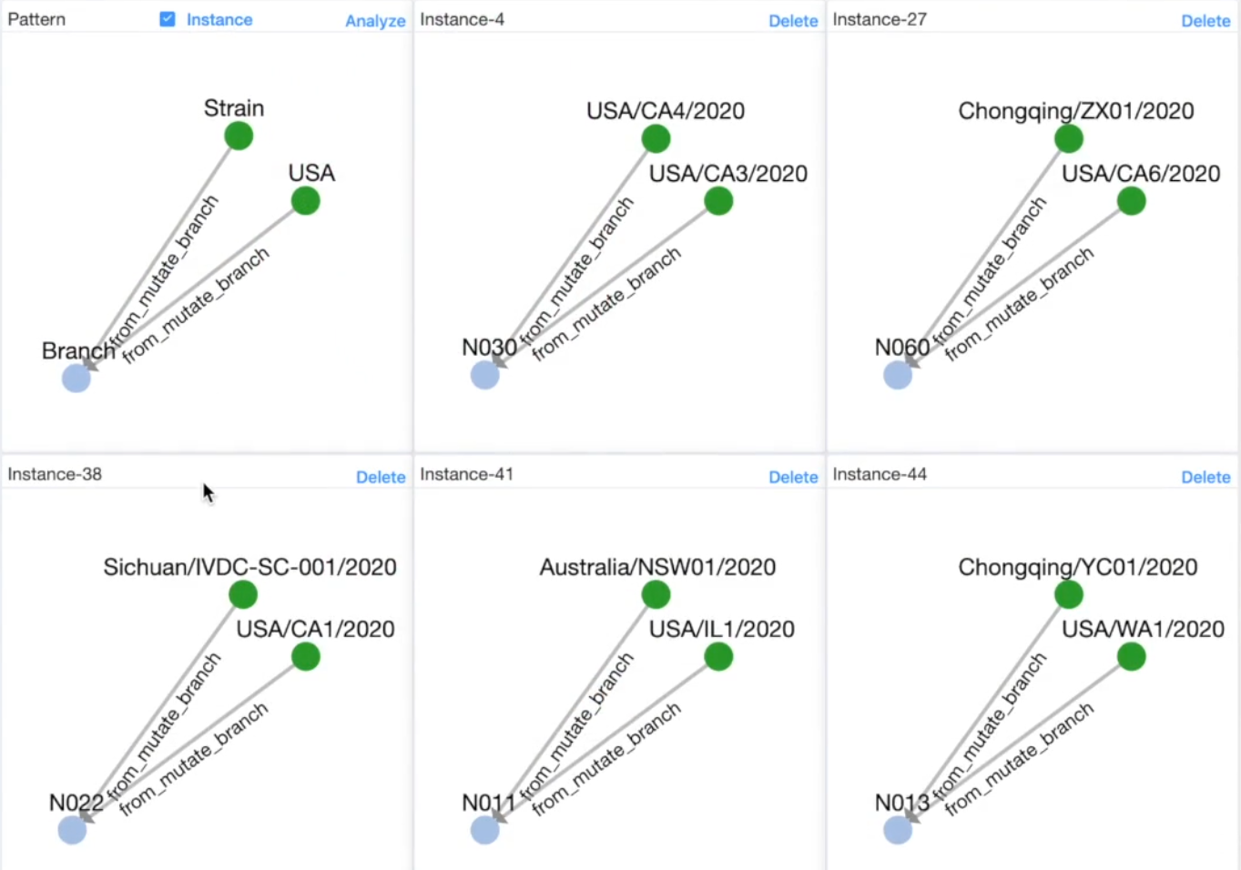
Mutate Branch Analysis
The mutate branches of strains in USA is not the same as in Wuhan

Slide 6
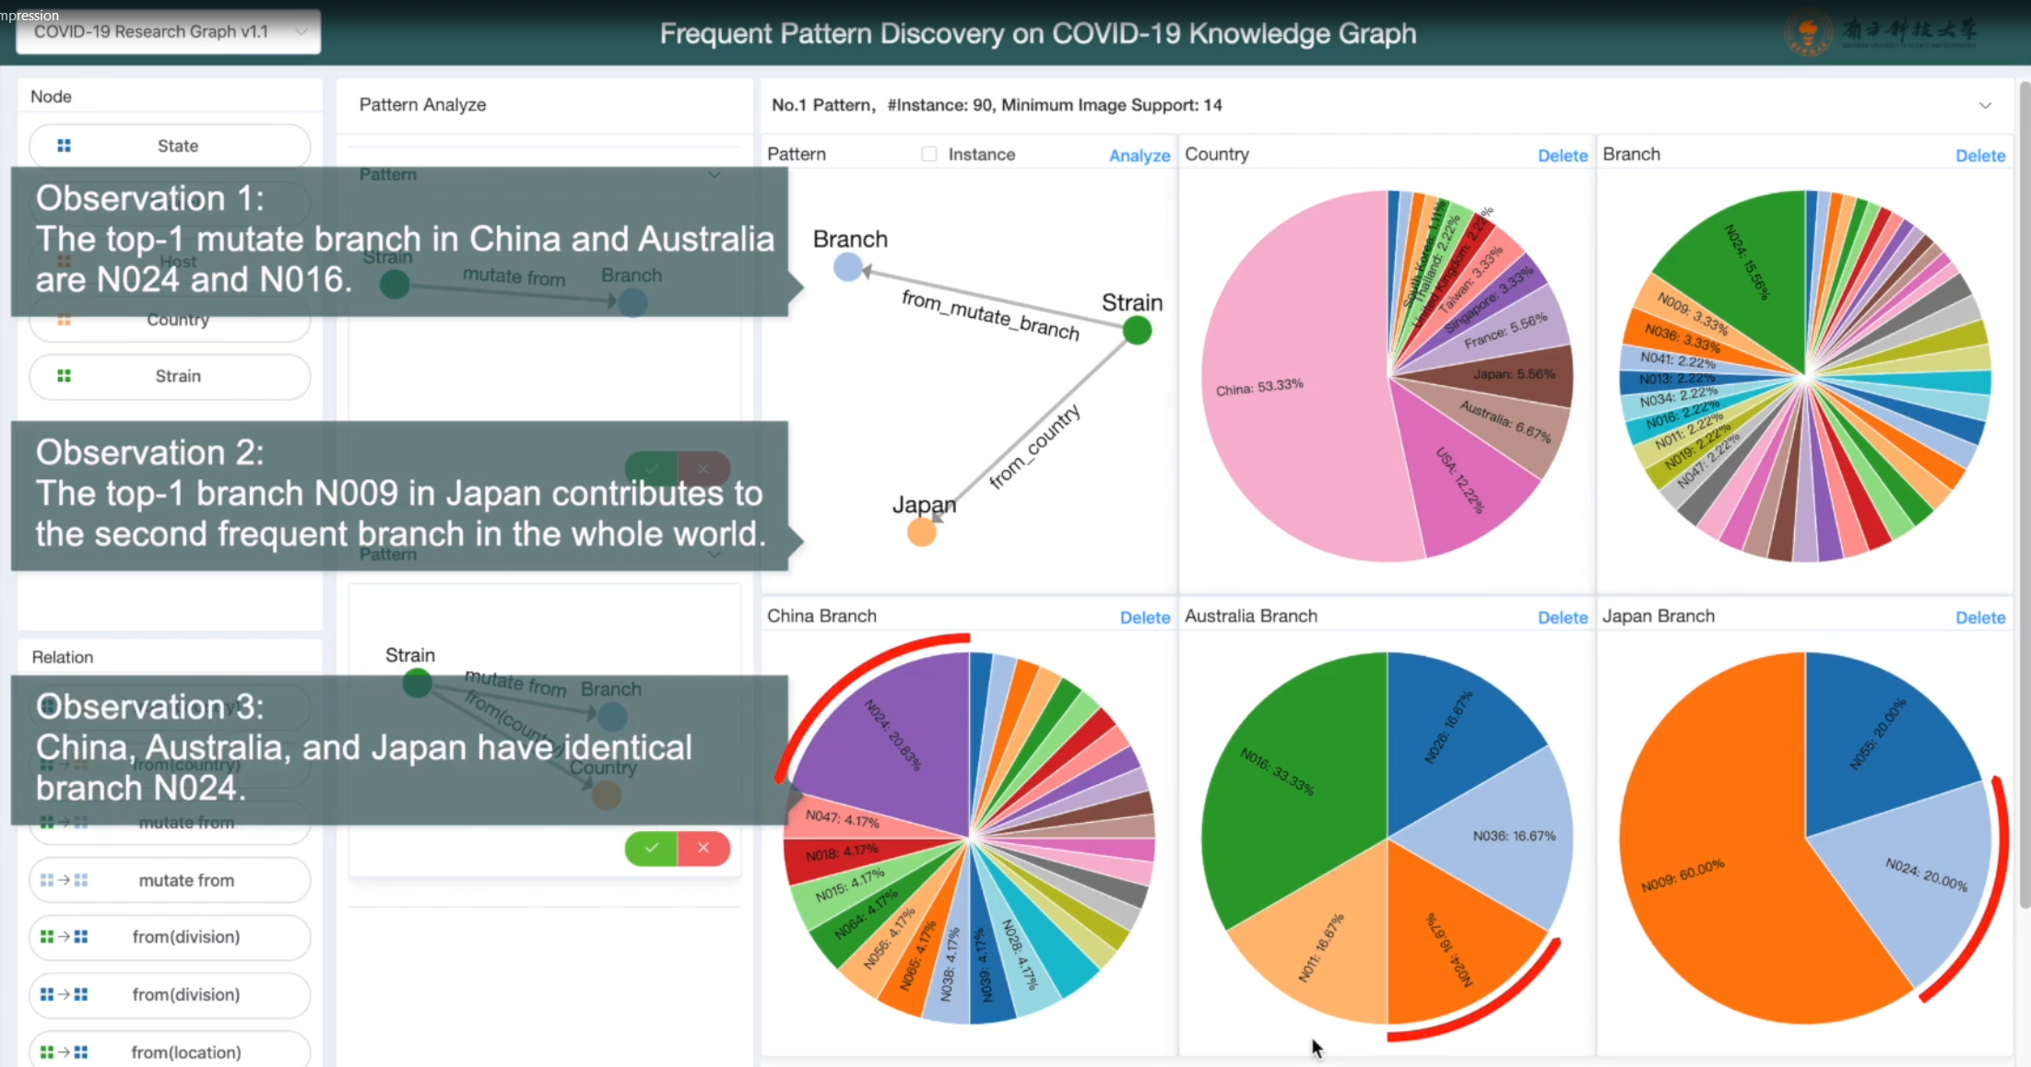
Mutate Branch Country Analysis

Slide 7
Thank you!

